Slide 1
The Peripheral Nervous System
DR.T.AJAYAN
PROF. & H.O.D.
PM

Slide 2
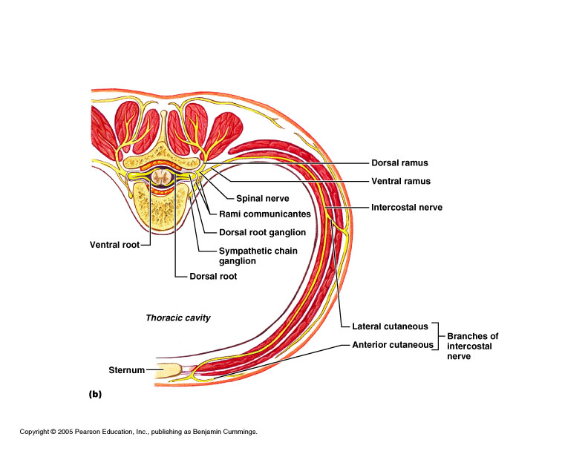
The Peripheral Nervous System

Slide 3
Peripheral Nervous System ways to categorize:
Motor or sensory
General (widespread) or specialized (local)
Somatic (outer tube) or visceral (inner tube)

Slide 4
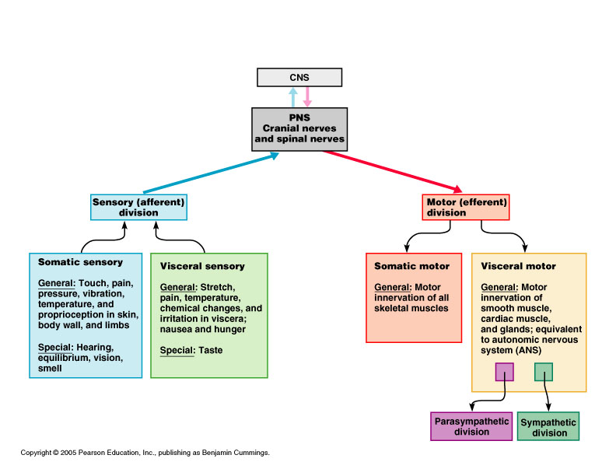
____Cranial nerves attach to brain
___Spinal nerves attach to spinal cord

Slide 5
Peripheral sensory receptors
By location:
Exteroceptors
Sensitive to stimuli arising from outside body
Interoceptors
Or visceroreceptors, from internal viscera
Proprioceptors
Monitor degree of stretch in skeletal muscles, tendons, joints and ligaments

Slide 6
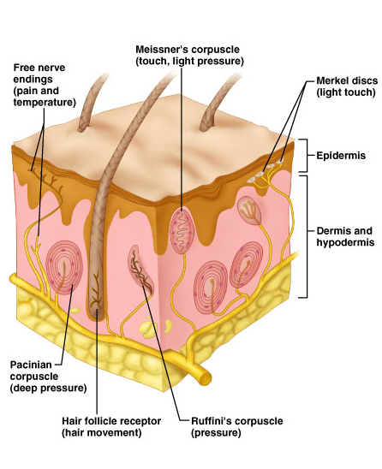
Sensory Receptors
Free nerve endings (pain and temp)
Merkel discs (light touch)
Root hair plexuses – entwine hair follicles (light touch)
Encapsulated Meissner’s corpuscles (light touch in hairless skin)
Ruffini’s corpusucles (deep pressure and stretch)
Pacinian corpuscles (deep pressure, vibration, visceral: pain, nausea, hunger, fullness)

Slide 7
Proprioceptors
Skeletal muscles, joints, tendons, ligaments
Degree of stretch, therefore information on body movement:
to cerebrum,
cerebellum and
spinal reflex arcs
Include: -Muscle spindles
-Golgi tendon organs
-Joint kinesthetic receptors

Slide 8
Proprioceptors continued
Muscle spindles:
Intrafusal fibers – rate & degree of stretch
Golgi tendon organs
Near muscle-tendon junction: monitor tension within tendons
Joint kinesthetic receptors
Monitor stretch in synovial joints
Send info to cerebellum and spinal reflex arcs

Slide 9
Peripheral motor endings
Innervation of skeletal muscle
Innervation of visceral muscles and glands

Slide 10
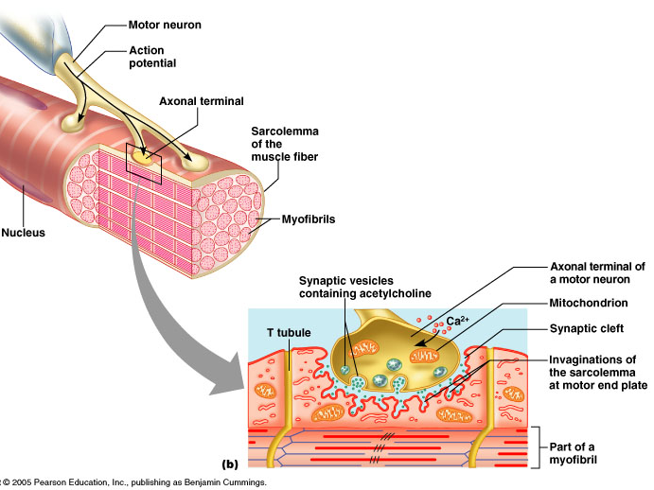
Motor axons innervate skeletal muscle fibers at neuromuscular junctions = motor end plates
Resemble nerve synapses between neurons, except for acetylcholinesterase:
breaks down acetylcholine so one twitch only

Slide 11
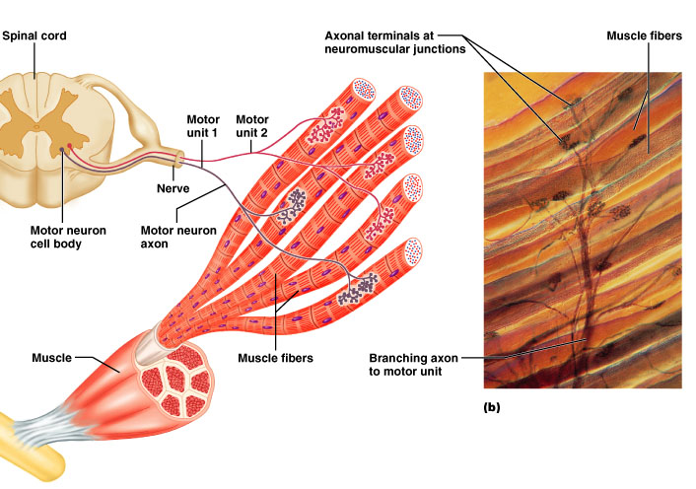
Motor unit: motor neuron & all the muscle fibers it innervates
All muscles in motor unit contract together when neuron fires
Stimulation of single motor unit causes weak contraction of entire muscle (spread out)
Those with fine control – fewer fibers per motor neuron (avg. 150: range is 4-100s)

Slide 12
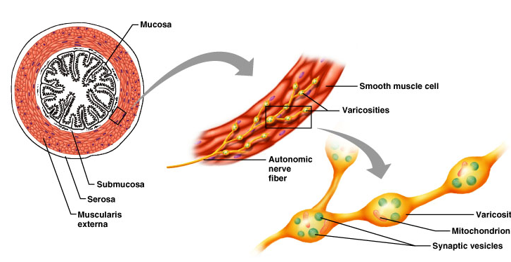
Innervation of visceral muscles & glands
Near end organ visceral motor axon swells = presynaptic terminals (vesicles with neurotransmitters): action slow (NT diffuses)

Slide 13
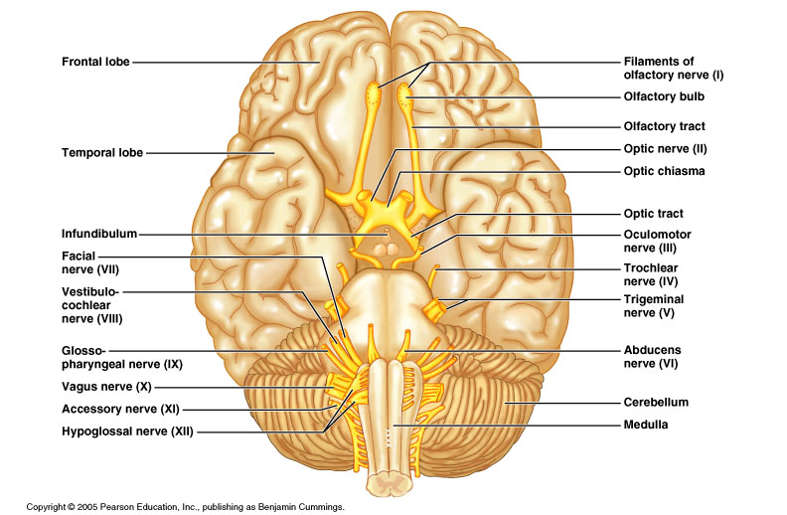
Cranial Nerves
Find as many as you can on model and sheep brain

Slide 14
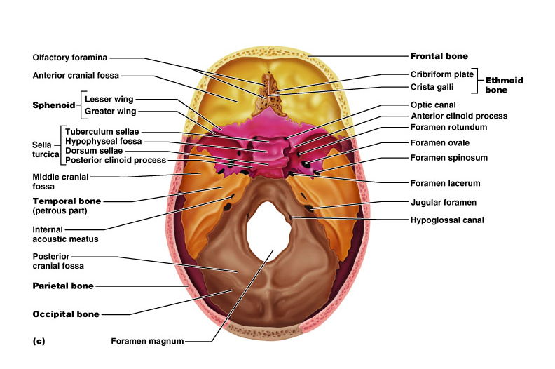
Review of foramina

Slide 15
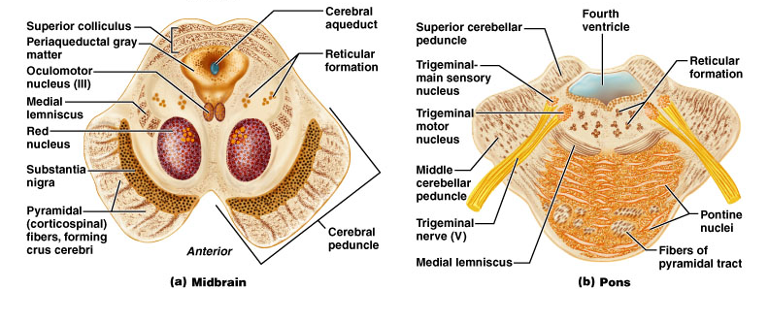
FYI: many cranial nerves have their nuclei in the brain stem (that’s why you’ll see that many attach to the brainstem)

Slide 16
Cranial nerves
12 pairs, Roman numerals I-XII
Serve mainly head and neck
Vagus – into thoracic and abdominal cavities
All but first 2 arise from brain stem and pass through foramina in base of skull
Most are mixed (motor and sensory)
3 are purely sensory:
Optic
Olfactory
Vestibulocochlear

Slide 17
Cranial Nerves
CN # | Name | Attached to | Foramen | Function
I | Olfactory | Forebrain | Cribriform plate | Sense of smell
II | Optic | Forebrain | Optic canal | Sense of vision (sight) from retina
III | Oculomotor | Midbrain (brainstem) | Superior orbital fissure | Motor to 4 of the 6 muscles of eye movement (up & in); eyelid; constriction of pupil
IV | Trochlear | Midbrain (brainstem) | Superior orbital fissure | Motor to superior oblique muscle of eye (down & out)
V | Trigeminal V1 ophthalmic V2 maxillary V3 mandibular | Pons (brainstem) | V1: superior orbital fissure V2: foramen rotundum V3: foramen ovale | All three divisions: facial sensation V3 (mandibular division): chewing also

Slide 18
VI | Abducens | Pons (brainstem) | Superior orbital fissure | Motor to lateral rectus muscle of eye (abducts outwards)
VII | Facial | Pons (brainstem) | Internal auditory canal | Facial expression (motor) Taste anterior 2/3 tongue Salivary & lacrimal glands (saliva and tears)
VIII | Vestibulocochlear | Pons (brainstem) | Internal auditory canal | Equilibrium (vestibular) Hearing (cochlear)
IX | Glossopharyngeal | Medulla (brainstem) | Jugular foramen | Taste & touch from posterior 1/3 tongue (sour, bitter); pharynx (throat) muscles of swallowing; parotid gland (saliva); senses carotid BP
X | Vagus | Medulla (brainstem) | Jugular foramen | Senses aortic BP, slows heart rate, stimulates digestive organs; larynx (vocal cords), taste, swallowing
XI | Accessory | Medulla (brainstem) | Jugular foramen | Sternocleidomastoid, trapezius, swallowing; part joins Vagus
XII | Hypoglossal | Medulla (brainstem) | Hypoglossal canal | Innervation of tongue muscles

Slide 19
Demonstration of testing of cranial nerves
I Olfactory: usually only done by neurologists: sniff e.g. coffee grounds, vanilla
II Optic: vision (eye chart), visual fields (grossly or formally), fundoscopy
III Oculomotor: pupilary reflexes (constriction to light); test with IV and VI for EOMs (extraocular movements) – follow finger
IV Trochlear: motor to superior oblique (test with EOMs – problem if eye can’t go down and out)

Slide 20
V trigeminal: largest cranial nerve; sensory info from face, 3 divisions (“tri”):
V1 ophthalmic
V2 maxillary
V3 mandibular
Light touch in cursory exam
Plus corneal reflex (neurologists usually)
Motor (V3): clench teeth, open mouth against resistance, move jaw side to side

Slide 21
VI Abducens: motor to lateral rectus of eye
(abducts eye outward)
VII Facial: (mixed) – facial expression
Symmetry (droop of eyelid, corner of mouth, etc.); wrinkle forehead, close eyes, smile, pucker etc.;
Taste anterior 2/3 tongue & tearing (neurologist)
VIII Vestibulocohclear (old: auditory): hearing by air and bone conduction (tuning fork)
IX Glossopharyngeal (mixed): uvula, gag reflex, cough, +taste posterior 1/3 tongue (neurologist)

Slide 22
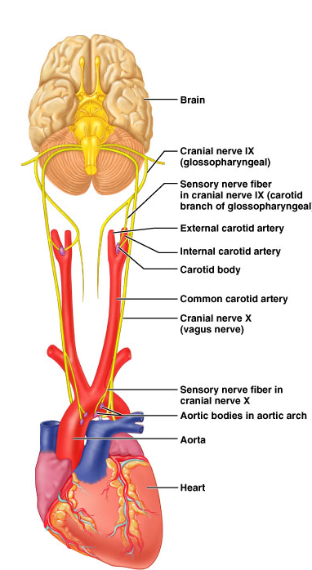
X Vagus (mixed): as IX (muscles of tongue and throat with IX)

Slide 23
XI Accessory (old: “spinal accessory”): sternocleidomastoid and trapezius (rotate head and shrug shoulders against resistance)
XII Hypoglossal: stick tongue out straight
Learn them; mneumonic helps, e.g.:
“Oh, oh, oh, to touch and feel very good velvet, ah!”

Slide 24
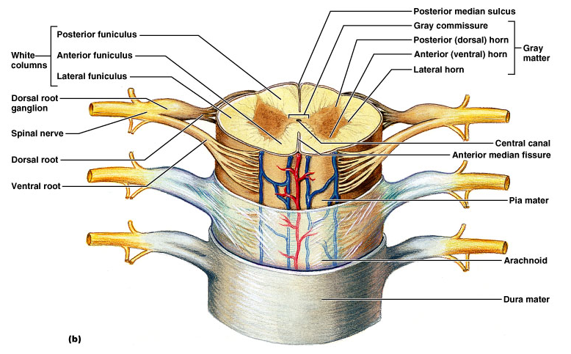
Spinal nerves
Part of the peripheral nervous system
31 pairs attach through dorsal and ventral nerve roots
Lie in intervertebral foramina

Slide 25
Spinal cord segments are superior to where their corresponding spinal nerves emerge through intervetebral foramina
Spinal nerves are named according to the spinal cord segment from which they originate
8 cervical
12 thoracic
5 lumbar
5 sacral
1 coccygeal
Cauda equina (“horse’s tail”): collection of nerve roots at inferior end of vertebral canal
http://www.apparelyzed.com/spinalcord.html

Slide 26
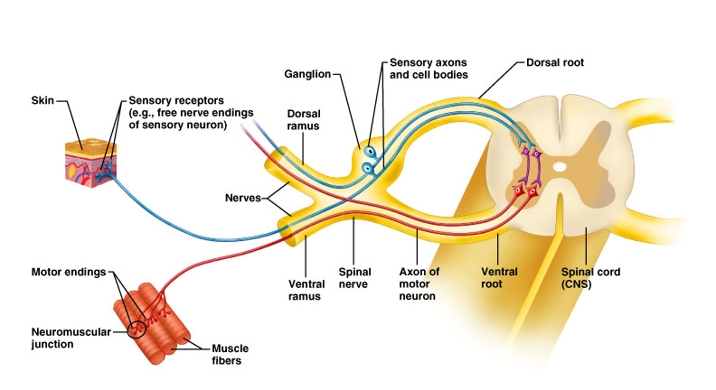
Spinal nerves
Dorsal roots – sensory fibers arising from cell bodies in dorsal root ganglia
Ventral roots – motor fibers arising from anterior gray column of spinal cord

Slide 27
Spinal nerves
Note: cervical spinal nerves exit from above the respective vertebra
Spinal nerve root 1 from above C1
Spinal nerve root 2 from between C1 and C2, etc.
The remaining spinal nerve pairs emerge from the spinal cord below the same-numbered vertebra
Clinically, for example when referring to disc impingement, both levels of vertebra mentioned, e.g. C6-7 disc impinging on root 7
Symptoms usually indicate which level

Slide 28
Spinal nerves
Dorsal roots – sensory fibers arising from cell bodies in dorsal root ganglia
Ventral roots – motor fibers arising from anterior gray column of spinal cord
(not labeled on drawing)

Slide 29
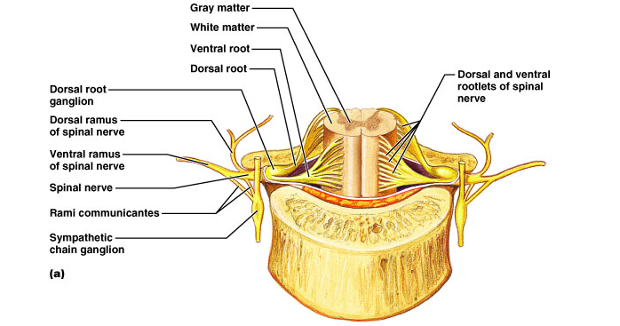
Dorsal and ventral roots join in an intervertebral foramen forming spinal nerve
Outside foramen, re-branch as rami (sing., ramus): Dorsal and ventral rami (somatic) Rami communicantes (visceral)

Slide 30
Dorsal rami serve the muscles and skin of the posterior trunk
Back, from neck to sacrum, innervated in a neatly segmented pattern: horizontal strip at same level as emergence from spinal cord
Ventral rami serve the muscles and skin of the lateral and anterior trunk
In thorax only, a simple segmented pattern as intercostal nerves
Also serve the limbs

Slide 31
Cross section of thorax showing main roots and branches of a spinal nerve
Note dorsal and ventral roots and rami, and rami communicantes
In the thorax, each ventral ramus continues as an intercostal nerve

Slide 32
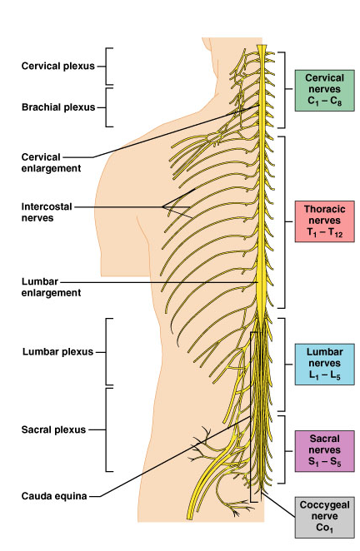
Nerve plexuses
Networks of successive ventral rami that exchange fibers (crisscross & redistribute)
Why would this be protective?
Mainly innervate the limbs
Thoracic ventral rami do not form nerve plexuses

Slide 33
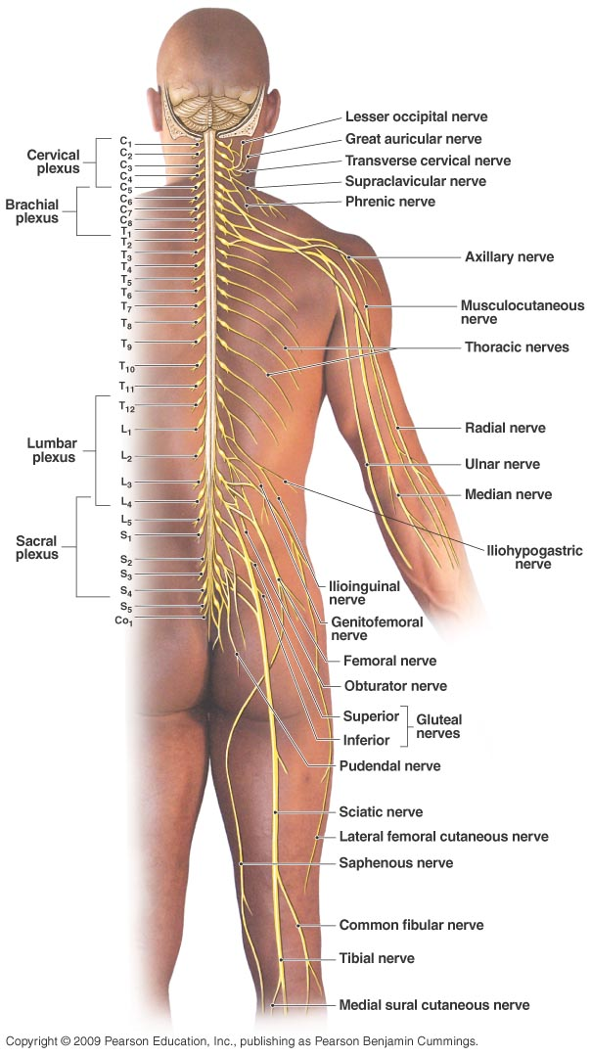
Plexuses
Cervical
Brachial
Lumbar
Sacral

Slide 34
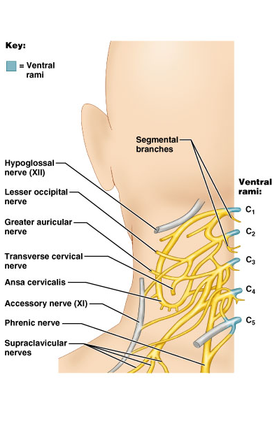
Nerve plexuses
Cervical plexus (C1-C4) innervates the muscles and skin of the neck and shoulder
most important:
Its phrenic nerve* (C3-C5) is the sole motor supply of diaphragm: one reason why neck injuries are so dangerous – can be lethal (respiratory arrest = stop breathing)
*

Slide 35
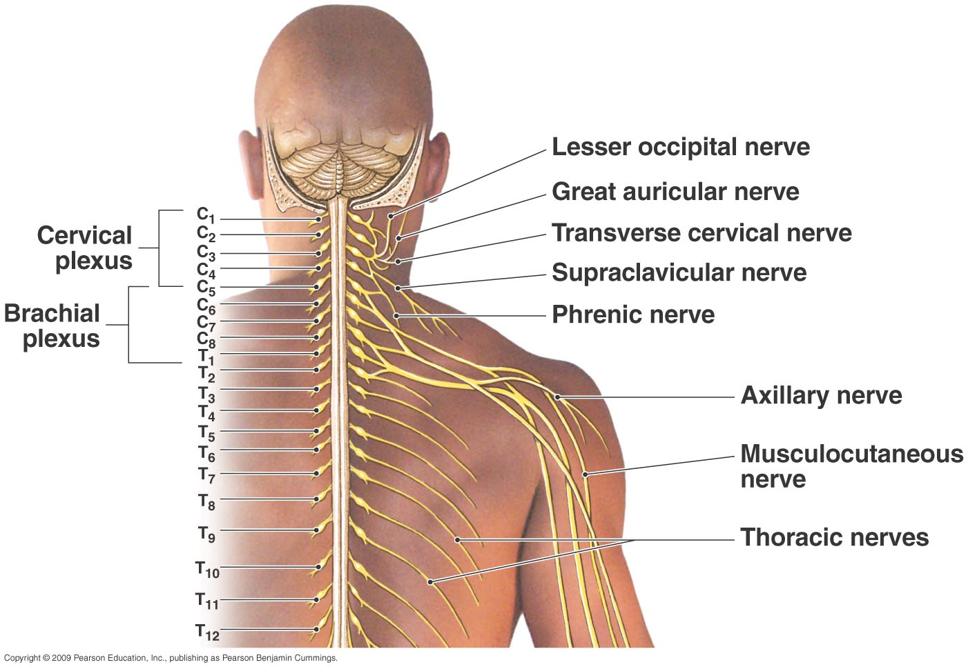

Slide 36
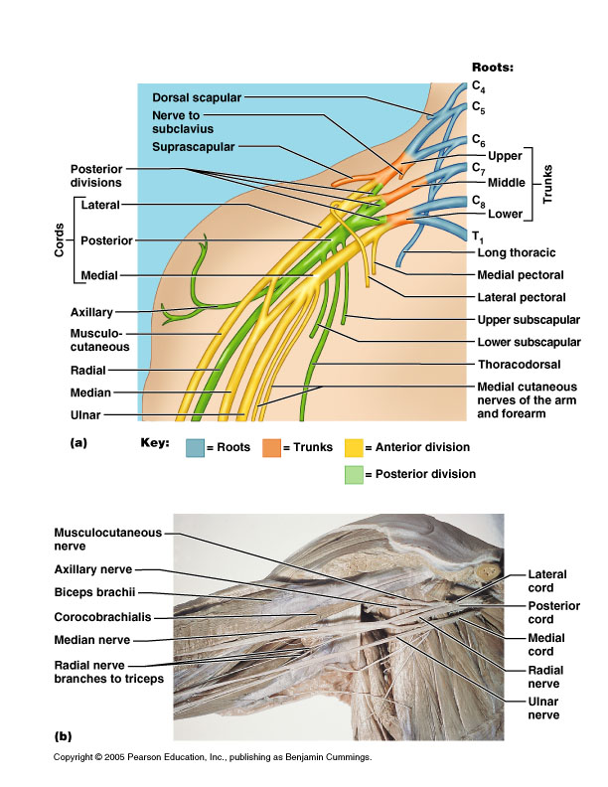
Brachial plexus
Serves upper limbs and shoulder girdle
Arises primarily from C5-T1
Main nerves (be able to label):
Musculocutaneous – to arm flexors
Median – anterior forearm muscles and lateral palm
Ulnar – anteromedial muscles of forearm and medial hand
Axillary – to deltoid and teres minor
Radial – to posterior part of limb

Slide 37
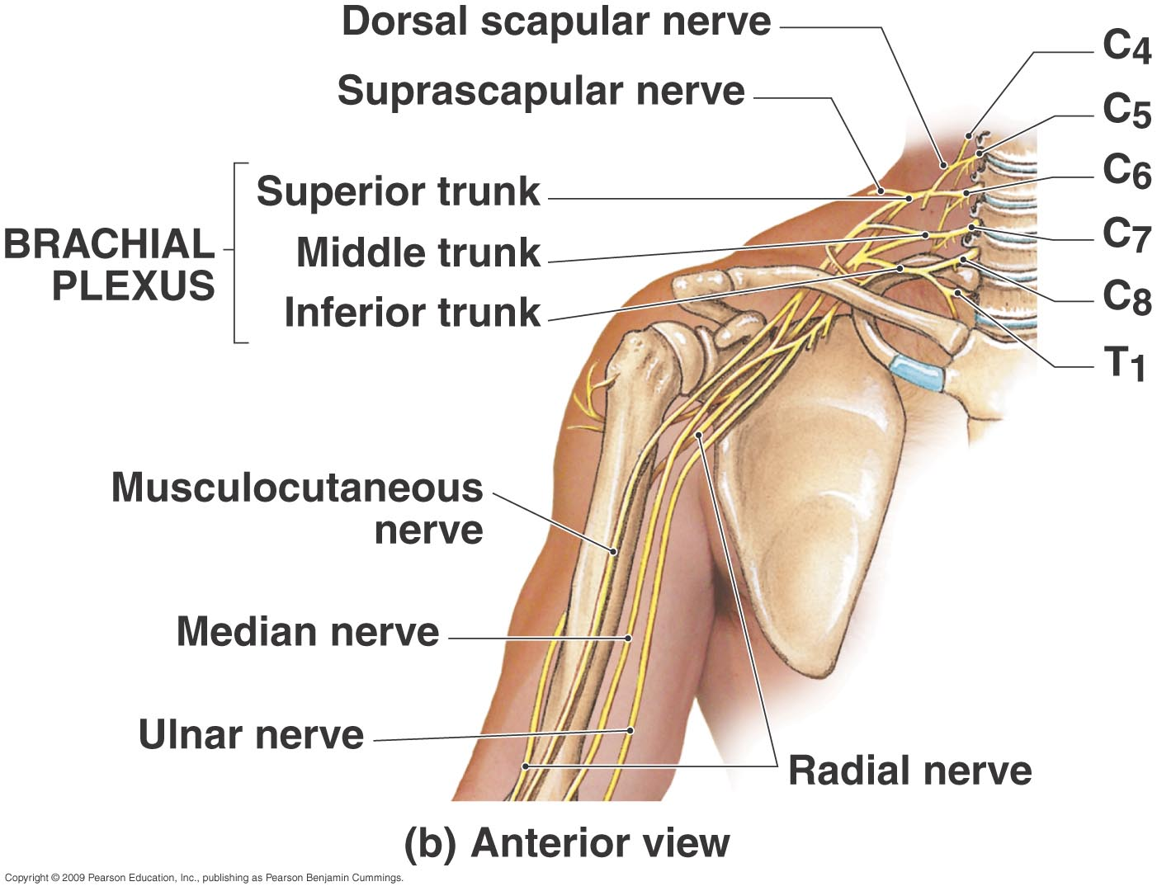

Slide 38
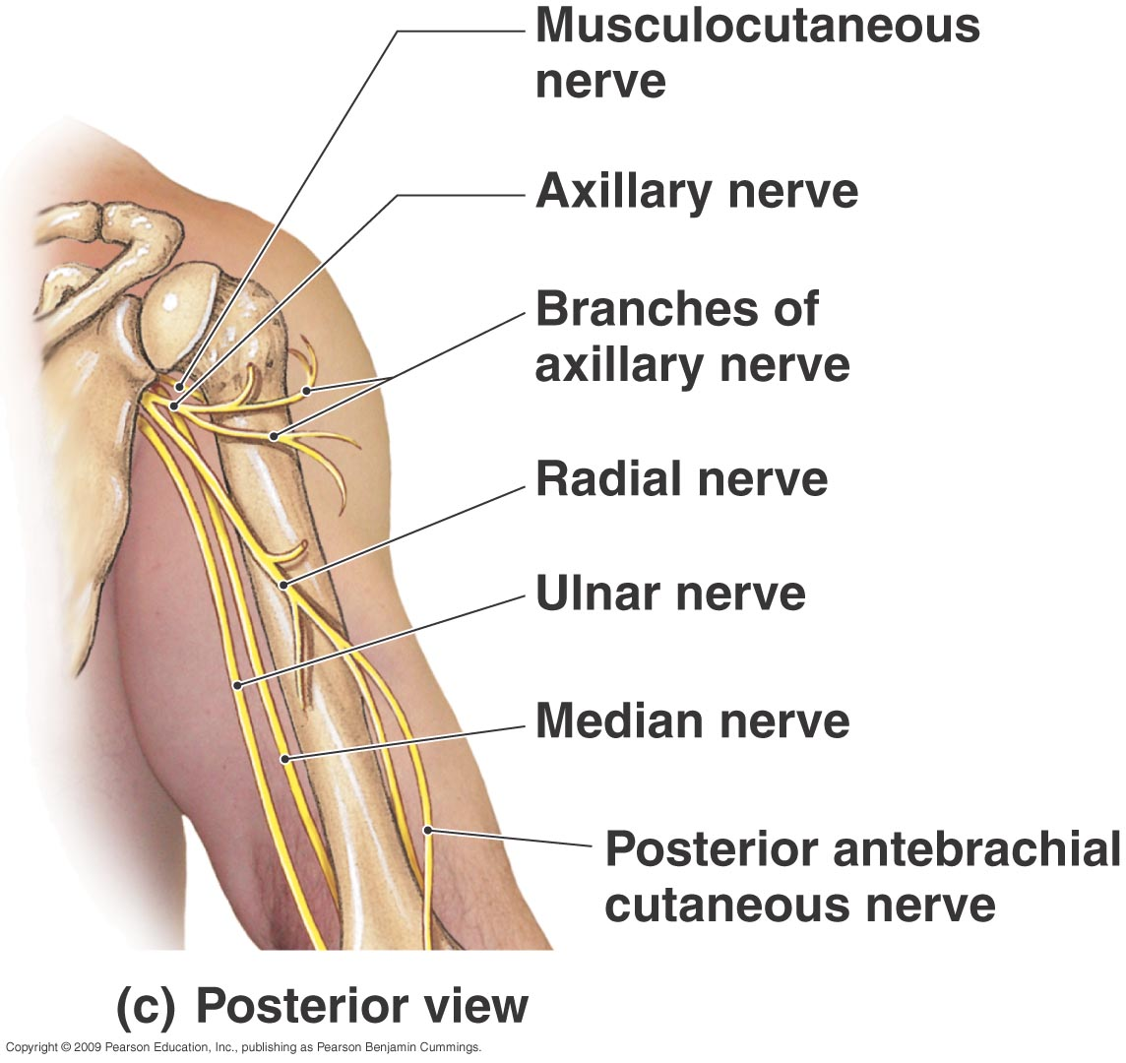

Slide 39
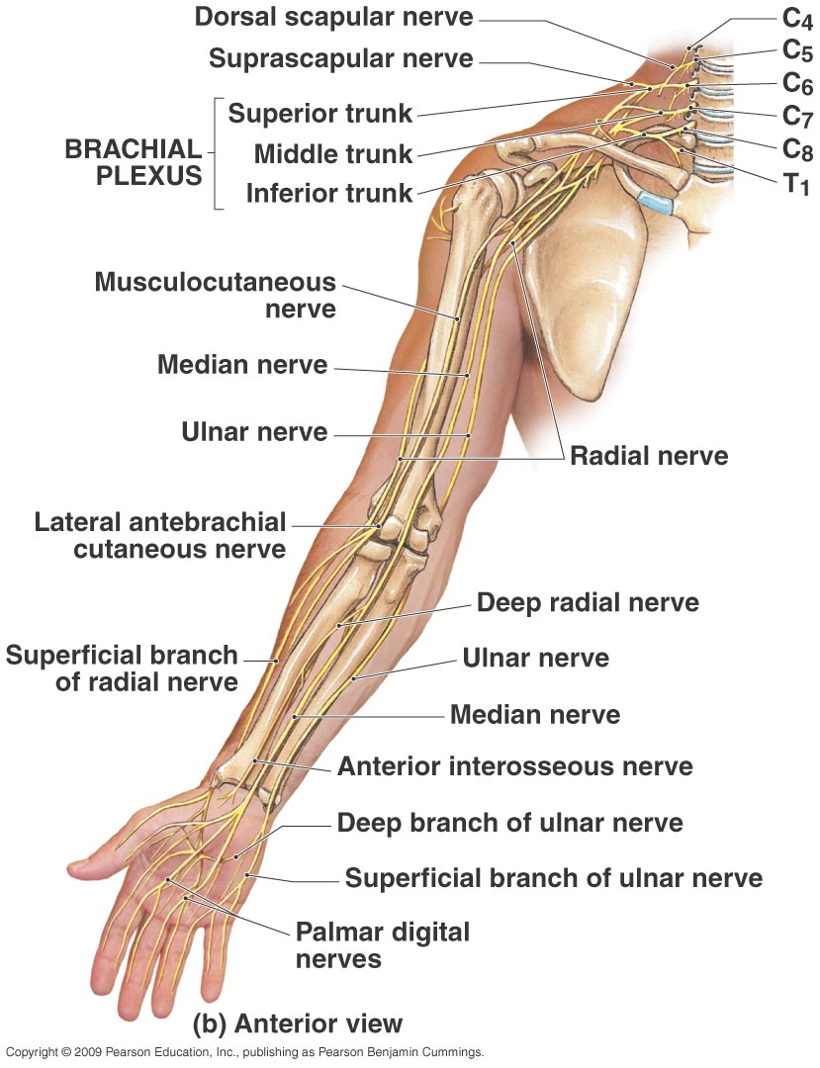

Slide 40
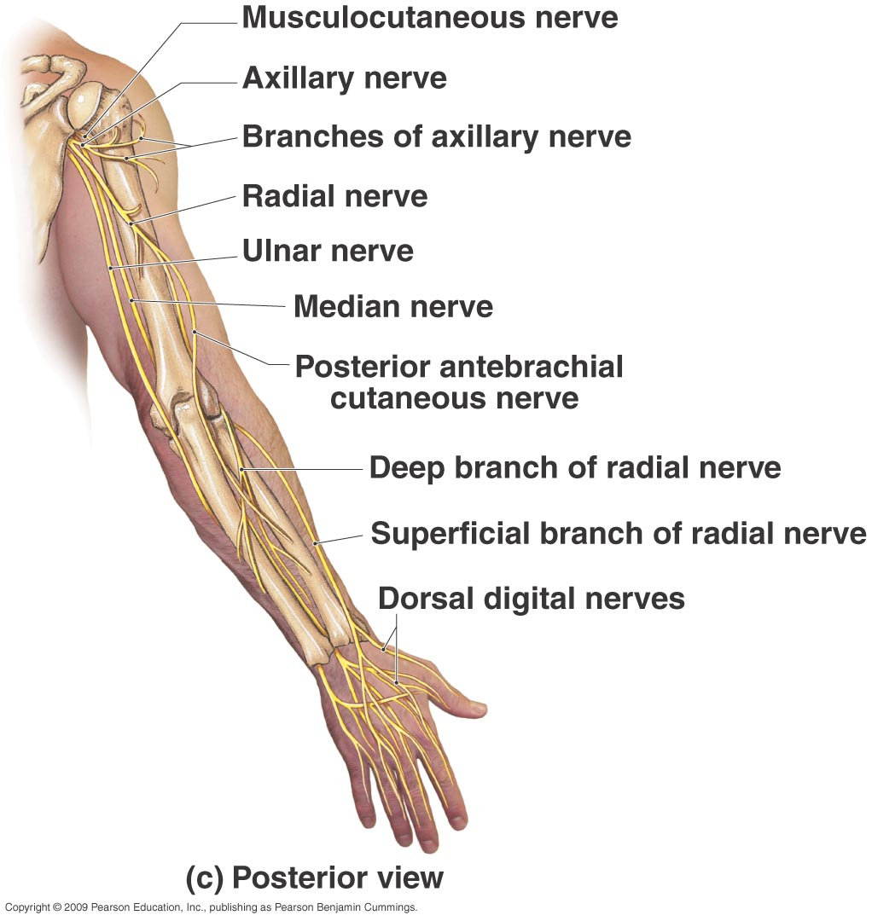

Slide 41
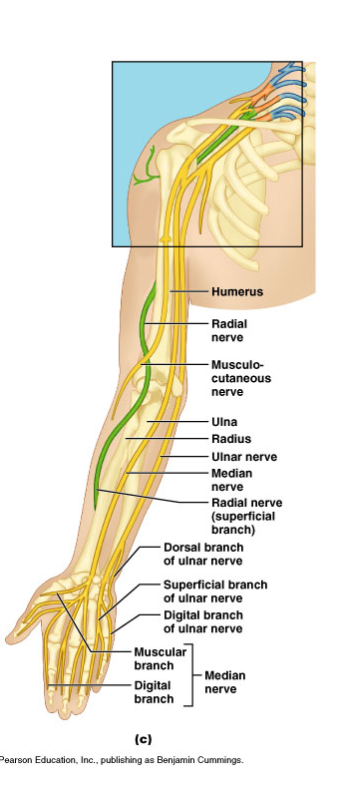
Musculo-cutaneous Median Ulnar Axillary Radial

Slide 42
Brachial plexus

Slide 43
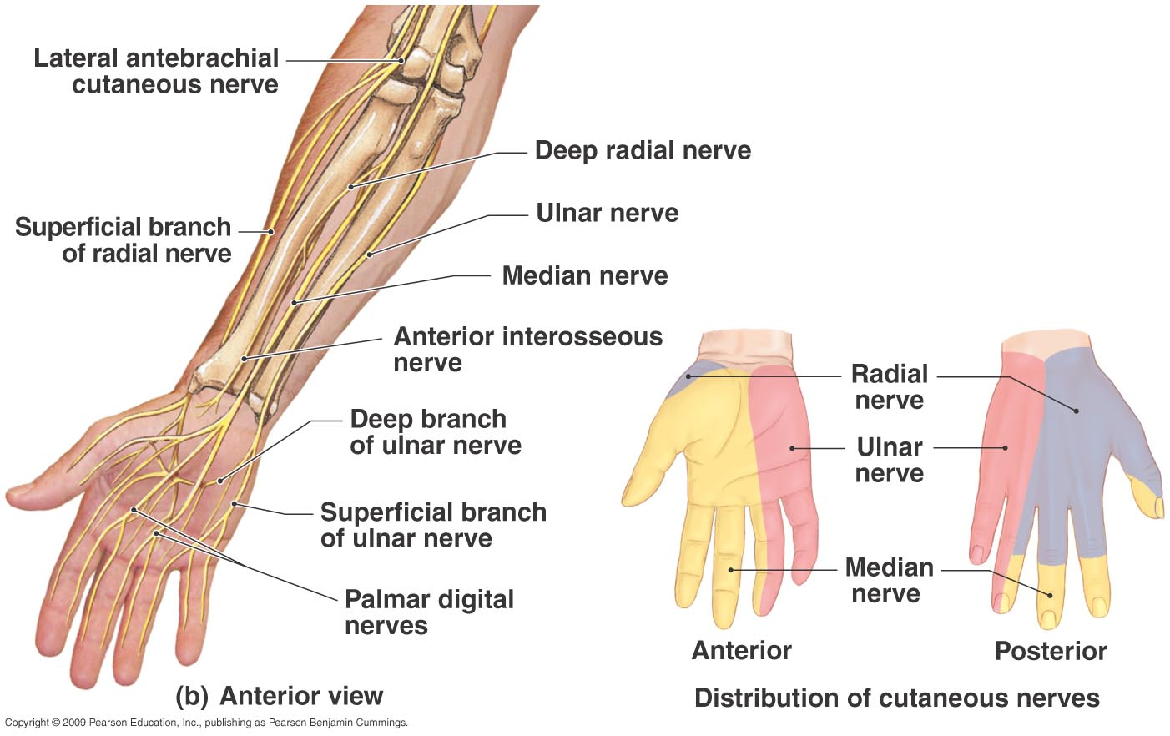
Note distribution of cutaneous nerves

Slide 44
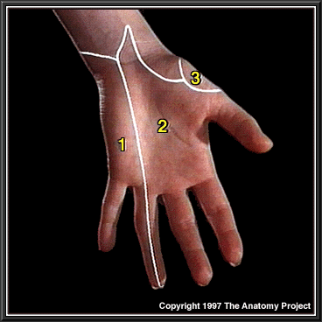
Sensory innervation, palm
Ulnar nerve
Median nerve
Radial nerve

Slide 45
Lumbar plexus
L1-L4
Lies within the psoas major muscle
Innervates anterior and medial muscles of thigh through femoral and obturator nerves respectively
Femoral nerve also innervates skin on anterior thigh (including quads) and medial leg

Slide 46
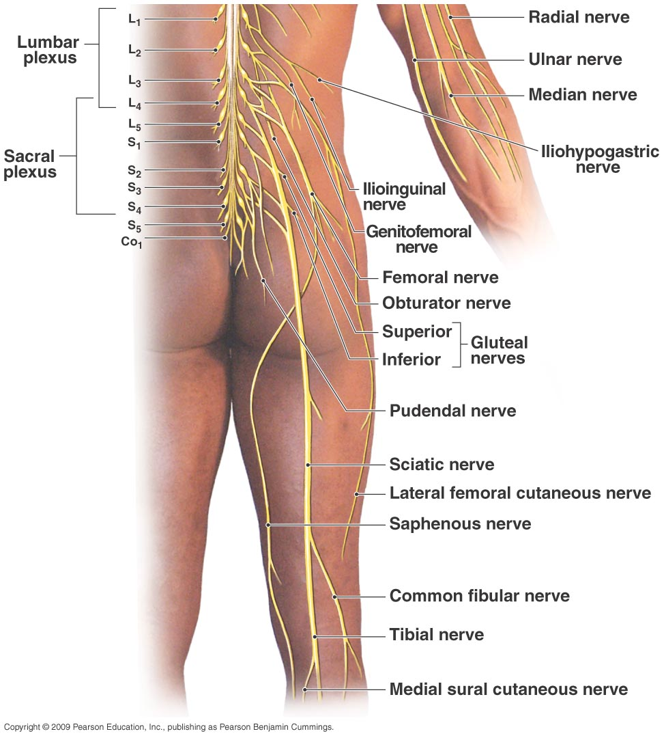
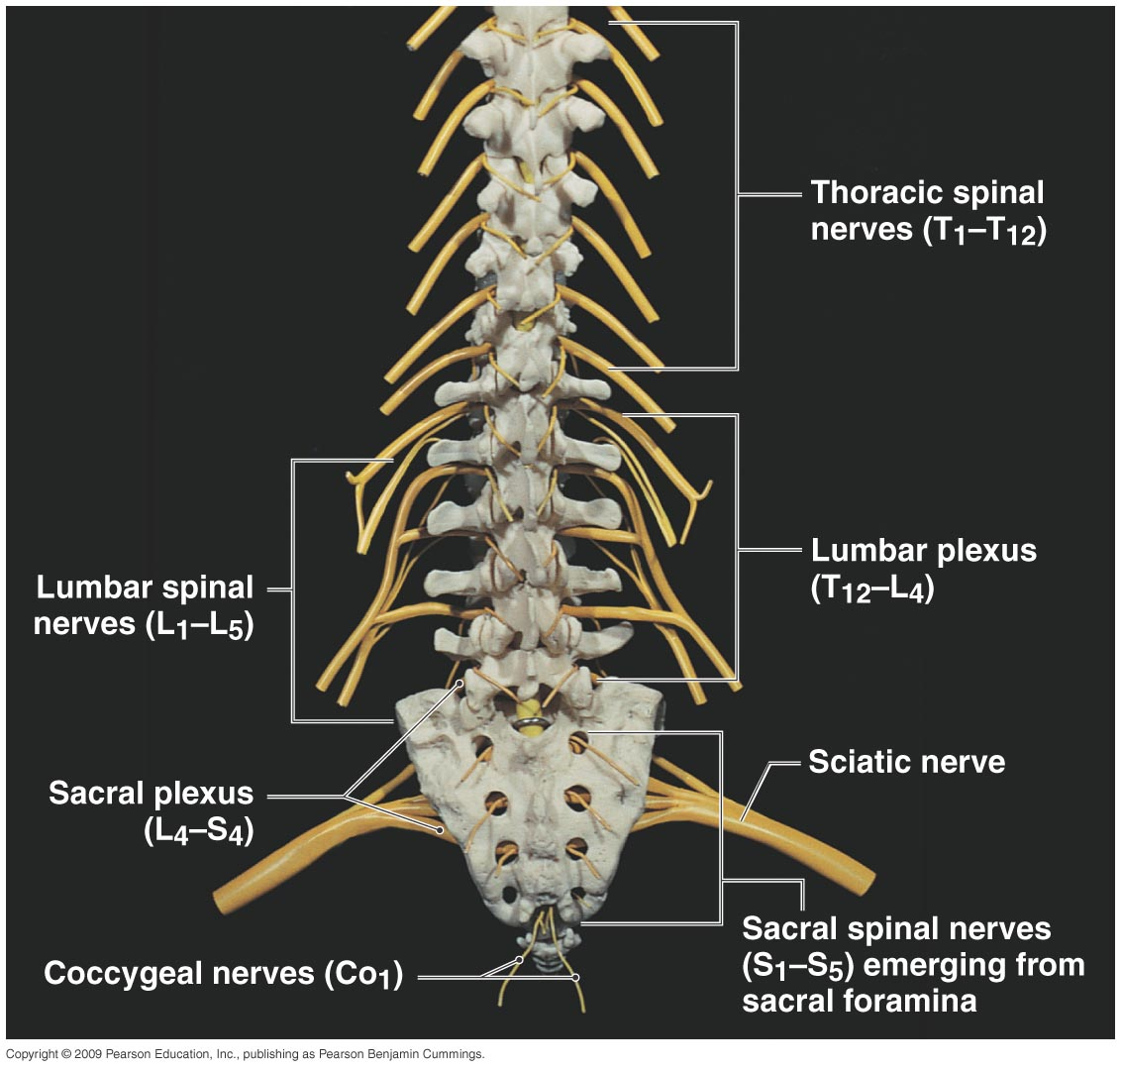

Slide 47
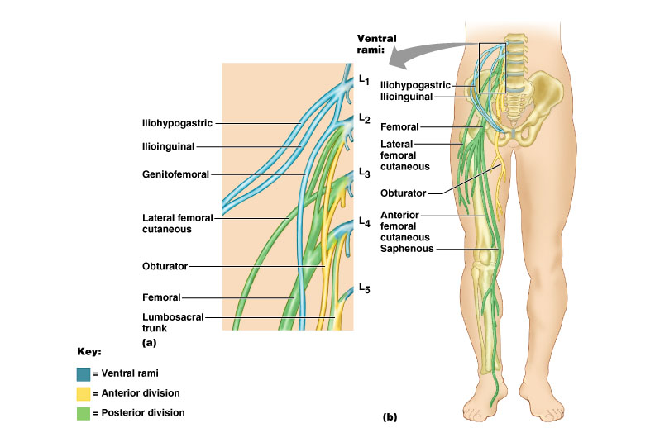
Lumbar plexus (be able to label femoral, obturator and saphenous nerves)

Slide 48
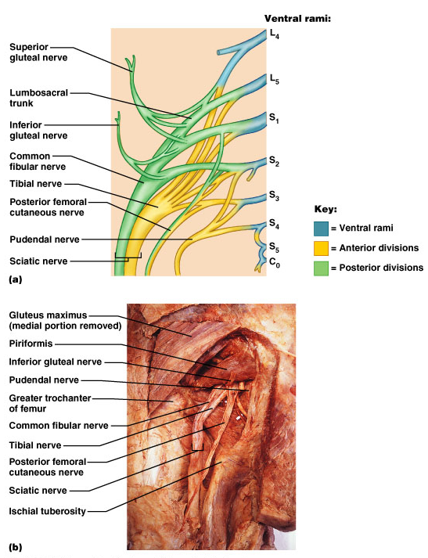
Sacral plexus
L4-S4
Supplies muscles and skin of posterior thigh and almost all of the leg
Main branch is the large sciatic nerve, which consists of:
Tibial nerve – to most of hamstrings, calf and sole
Common fibular nerve – to muscles of anterior and lateral leg and skin
Other branches supply pelvic girdle (gluteus muscles) and perineum (pudental nerve)

Slide 49
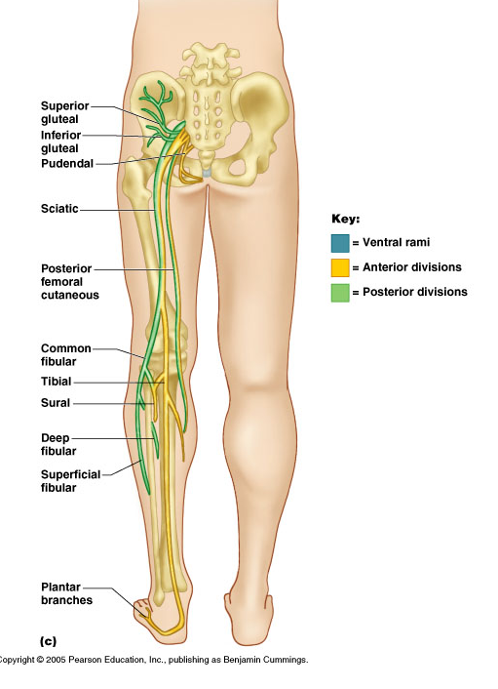
Sacral plexus nerves:
(Be able to label sciatic, tibial and common fibular nerves)

Slide 50
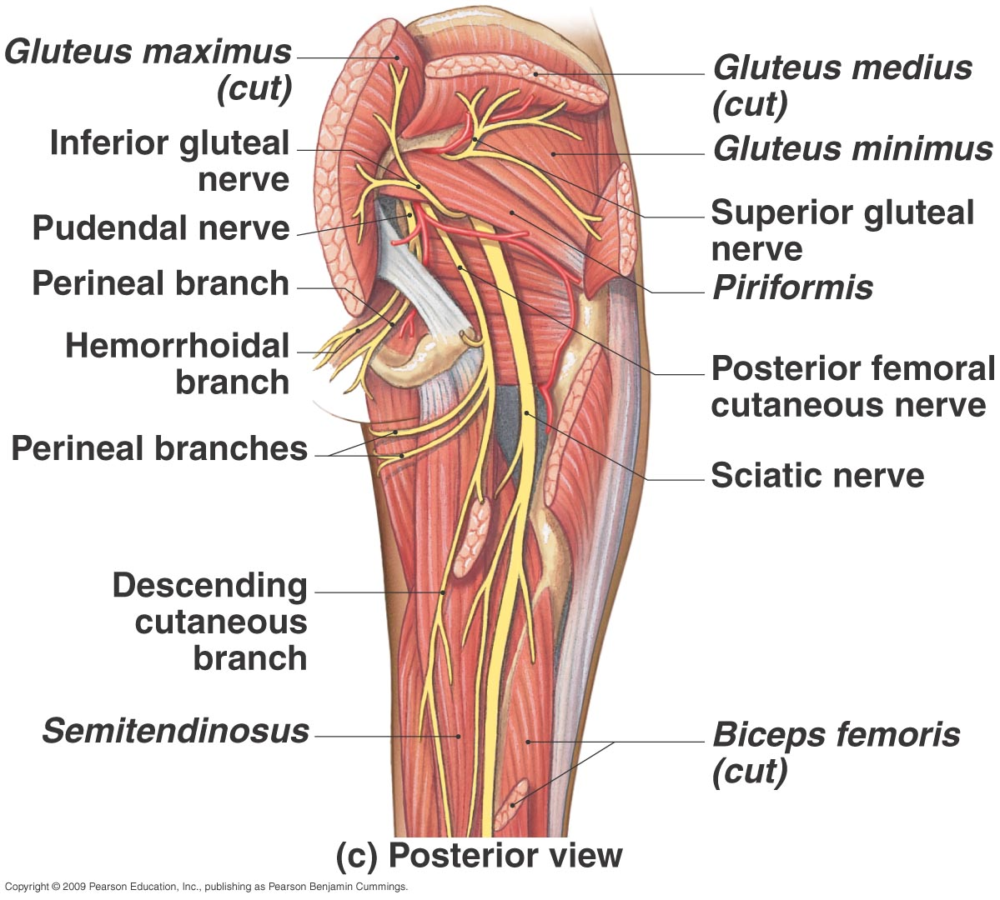

Slide 51
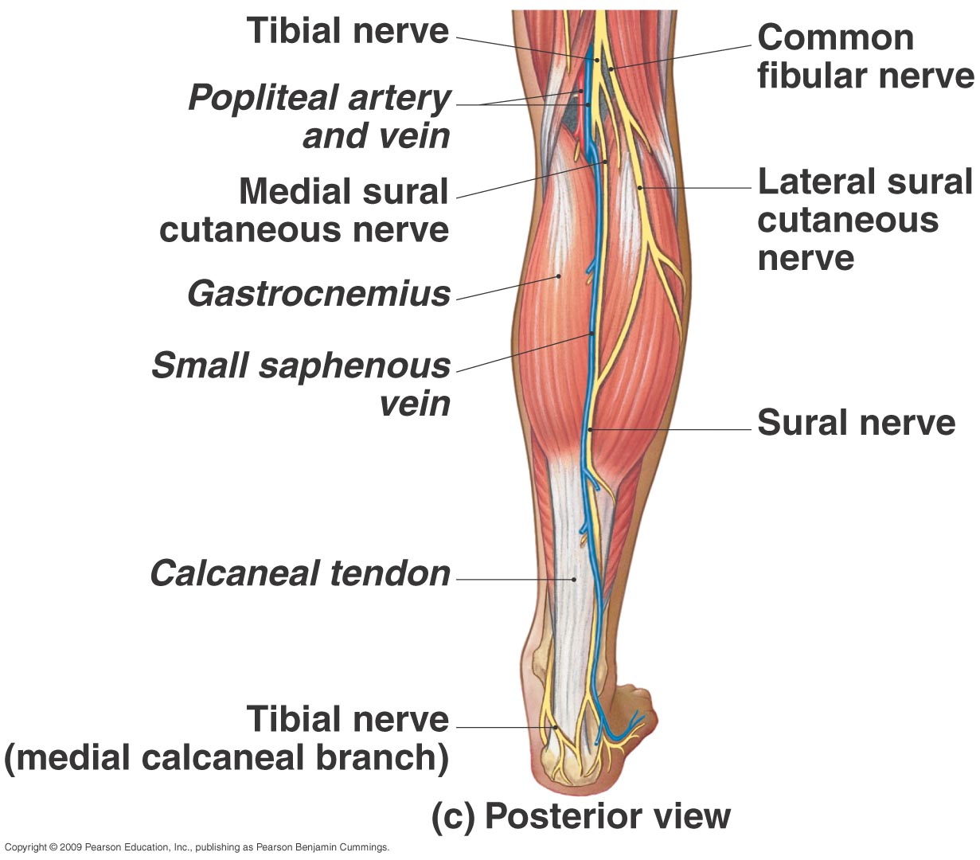

Slide 52
Nerve plexuses (very) simplified….
Cervical plexus C1-5
Brachial plexus C5-T1
Lumbar plexus L1-4
Sacral plexus L4-S4
Diaphragm?
Phrenic nerve C3-5
Arm and forearm extensors?
Radial nerve
Medial hand?
Ulnar nerve
Lateral palm?
Median nerve
Quad?
Femoral nerve
Footdrop?
Common fibular/peroneal nerve
(branch of Sciatic nerve)

Slide 53
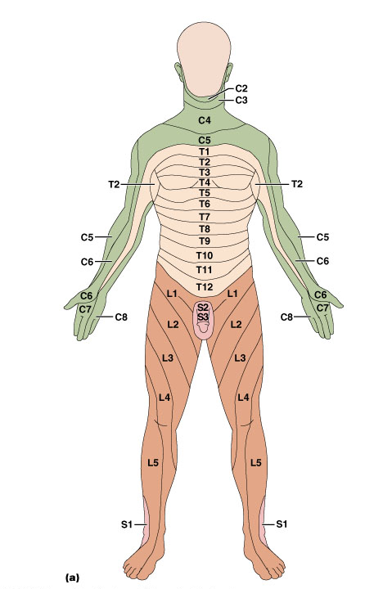
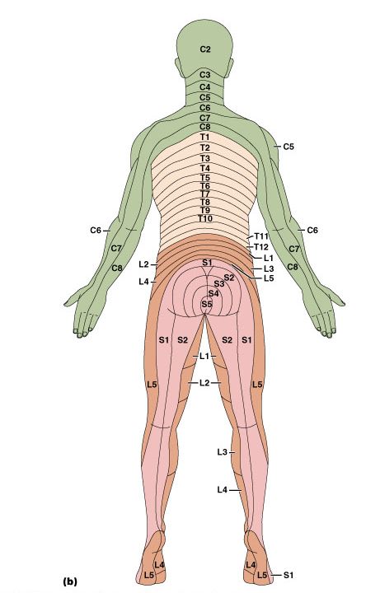
Dermatomes (innervation of skin)
Dermatomes
(area of skin innervated by the cutaneous branches from a single spinal nerve is called a dermatome)
Reveal sites of
damage to spinal
nerves or spinal cord

